Slide 1



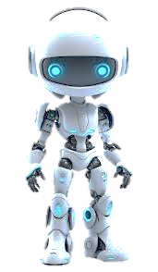
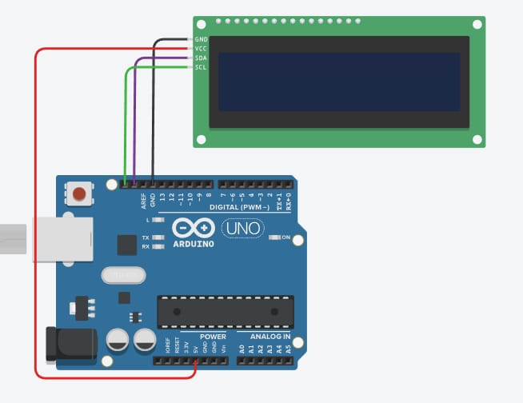
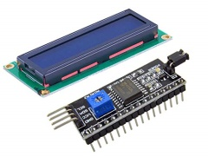
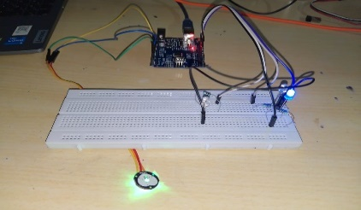
Vidya Pratishthan’s Kamalnayan Bajaj Institute Of Engineering & Technology,Baramati
Department Of Airtificial Intelligence & Data science Engineering
Stress Detection & Relaxation System
Introduction
Circuit Diagram
Applications
The Stress detection system is the base technology behind stress relaxation. This system can monitor as well as gives suggestion/instructions on the basis of pulse rate conditions of user. For those who don’t understand the values of pulse rates we can place Led’s of different colors i.e. red led for hyper pulse rate, for normal it is green, for lower it is blue. Like other wearable devices it does not only show the average rating values but also gives values per Milli second. It is more accurate and more convenient and also more precise
Many Wearable devices cannot measure real time values of heart rate but using this model this is possible
Nowadays heart strokes became not only common but also unnoticeable, but using this model it can be acquired
Objective
Conclusion
Real Time Stress Detection
The primary objective of stress detection system is to continuously monitoring the pulse rates so that the user gets best suggestion/instructions on the live condition of user
Simplified Stress Monitoring
The another key objective is to make user understand his own stress level without going to Hospital
Futuristic Approach
Statistic data
It is statistically proven that this model can measure heart rates more precisely and accurately
Multipurpose Model
With using a single base technology we can modify it into many applicable devices
Imperative Technology
By considering the rate of advancement it became essential to monitor stress levels and finding appropriate solutions.
Health Science
By Adding deep learning technology and human behaviour into this model, we could successfully track health records as well as mental well-being
Defence & security
We can make Lie Detectors By Combing This Heart rate Monitoring and facial Behaviour.
Veterinary science
By studying animal behavior with different heart rates and observing
the emotion pattern we can achieve great success in veterinary sciences
Components Required
Arduino UNO
Pulse Rate Sensor
Lcd Display
I2C Lcd Module
Breadboard
Jumper Cables
Led’s of Different Colours
Resistor Of Different Colors
Name of students
Vaishnavi Ganesh Kirve
Siddhi Anil Jadhav
Shreya Sanjay Bhoite
Reference
https://en.wikipedia.org/wiki/Heart_rate_monitor
https://www.arduino.cc/

